Slide 1



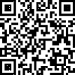
بِسْمِ اللهِ الرَّحْمٰنِ الرَّحِيْمِ “
In the name of Allah, the Most Gracious, the Most Merciful
Revolutionizing Flood Monitoring: A Web-Based Application
for Near-Real-Time Observation Using Satellite Imagery
Md. Imam Sohel Hossain
Senior Scientific Officer
Leather Research Institute
Bangladesh Council of Scientific and industrial Research (BCSIR)
BCSIR Congress-2023: Smart Bangladesh of Tomorrow is the Science of Today

Slide 2
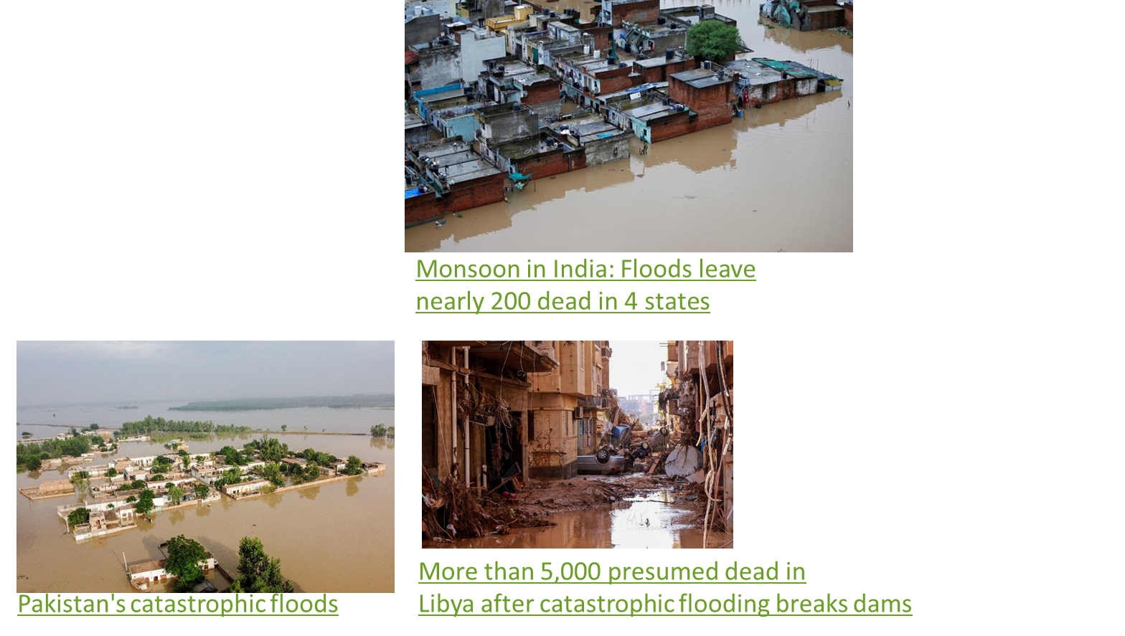
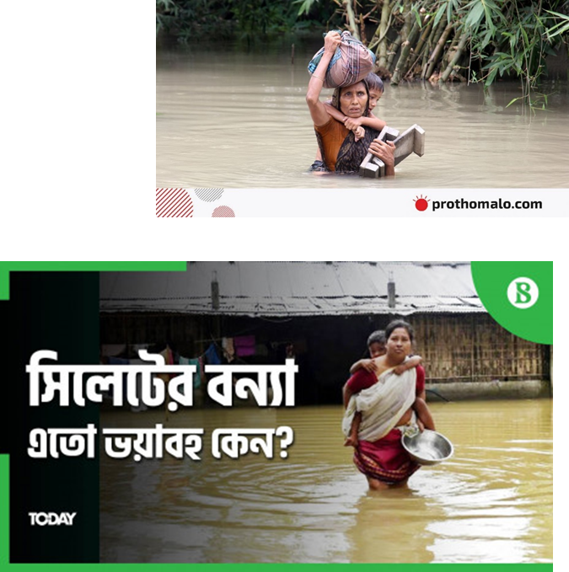
Background
Problems
World scenario-Pakistan, India, Libiya
Bangladesh overview regarding latest researches

Slide 3
Research gap with respect to critical analysis of literatures
Voluminous dataset store and analysis are tough in conventional way
In fact, traditional analysis is done by trained analysts on high powered computers, which can create a resource barrier for fiscally strained communities or those without advanced training
Moreover, flood monitoring in field based is expensive as well as time consuming
Readily observable field evidence of the largest or most recent natural disasters are difficult
For example, the timing and extent of a series of flooding events over many years will be difficult and expensive to determine with field methods alone
Apart from that field-verified inventories of spatially extensive events may take many months

Slide 4
Research Opportunity
Big Data
Cloud Storage
Flood
Monitoring
Parallel Computing

Slide 5
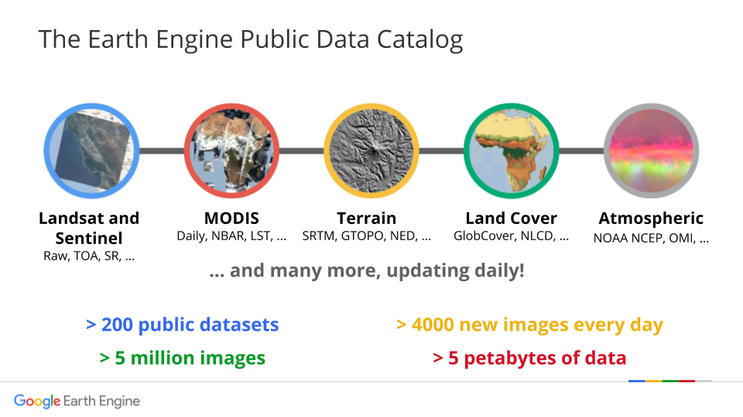
Research Opportunity
Game Changer-Google Earth Engine is a remote sensing data analysis platform designed to take advantage of Google’s infrastructure for data storage, access, processing, and visualization (Gorelick et al., 2017)
1 petabyte= 1024 TB= 1million GB
1. Gorelick et al., 2017. https://doi.org/10.1016/j.rse.2017.06.031, 2017

Slide 6
Objectives
Develop an cloud based application which could fetch data continuously from voluminous data.
Fast and reproducible estimation of the damage from local to regional scale regarding flood extent, population exposed, affected cropland and urban areas
Map flooded affected areas, croplands, populations and urban areas in near real time using Sentinel-1 SAR data, the GEE cloud computing platform
Open a platform for scientists and non scientists to explore and characterize the spatial pattern of flood by making it open source. The power of parallel computing will save our time for understanding the flood dynamics and spatial pattern for predicting future hazards and eventually decision making.

Slide 7
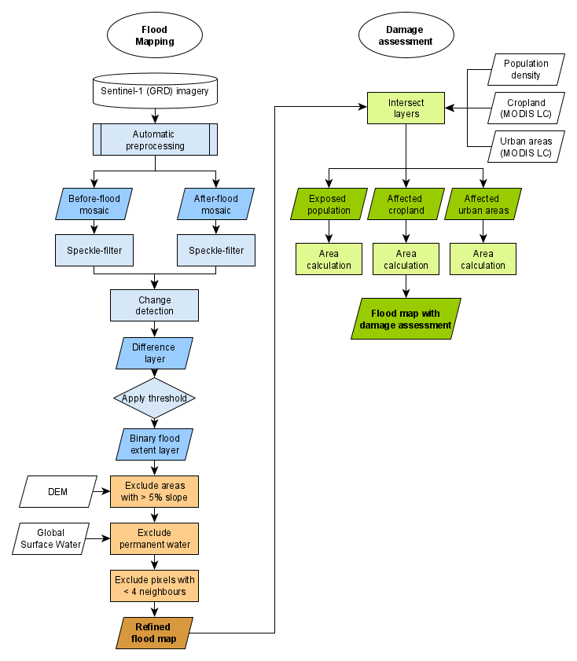
Methodology
Image differencing
Before and during/ after flood
Data used
Human settlement 2015, Modis 2015
Reference: UN Spider

Slide 8
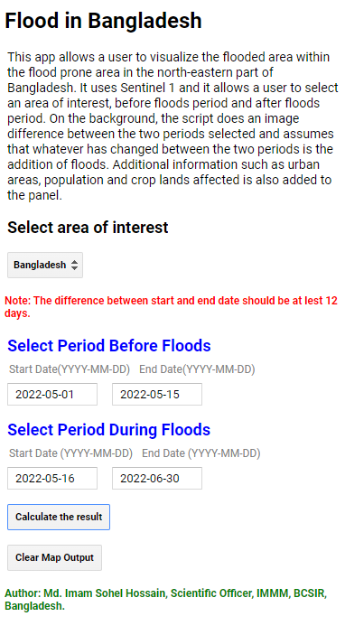
Findings-Cloud-Based App Development
https://imamsohel1991.users.earthengine.app/view/bangladesh-flood-cloud-computing
Input Variables | Definition | Example
Select area of interest | Choose an area to observe the flood condition | Sylhet, Gaibandha
Select Period Before Floods (start date, end date) | The range of date prior to the event | 01 May 2022, 15 May 2022
Select Period During Floods (start date, end date) | The range of date during the event | 16 May 2022, 30 May 2022
Calculate the result | Click to show the result
Clear map output | Click to clear the output
Dataset | Sentinel-1, Revisit time 6-12 days | Copernicus SAR(GRD) dataset

Slide 9
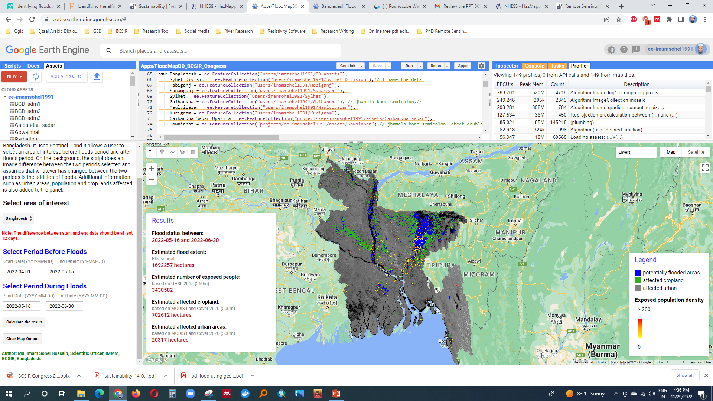
Findings-Regional Scale Flood Mapping and Estimation

Slide 10
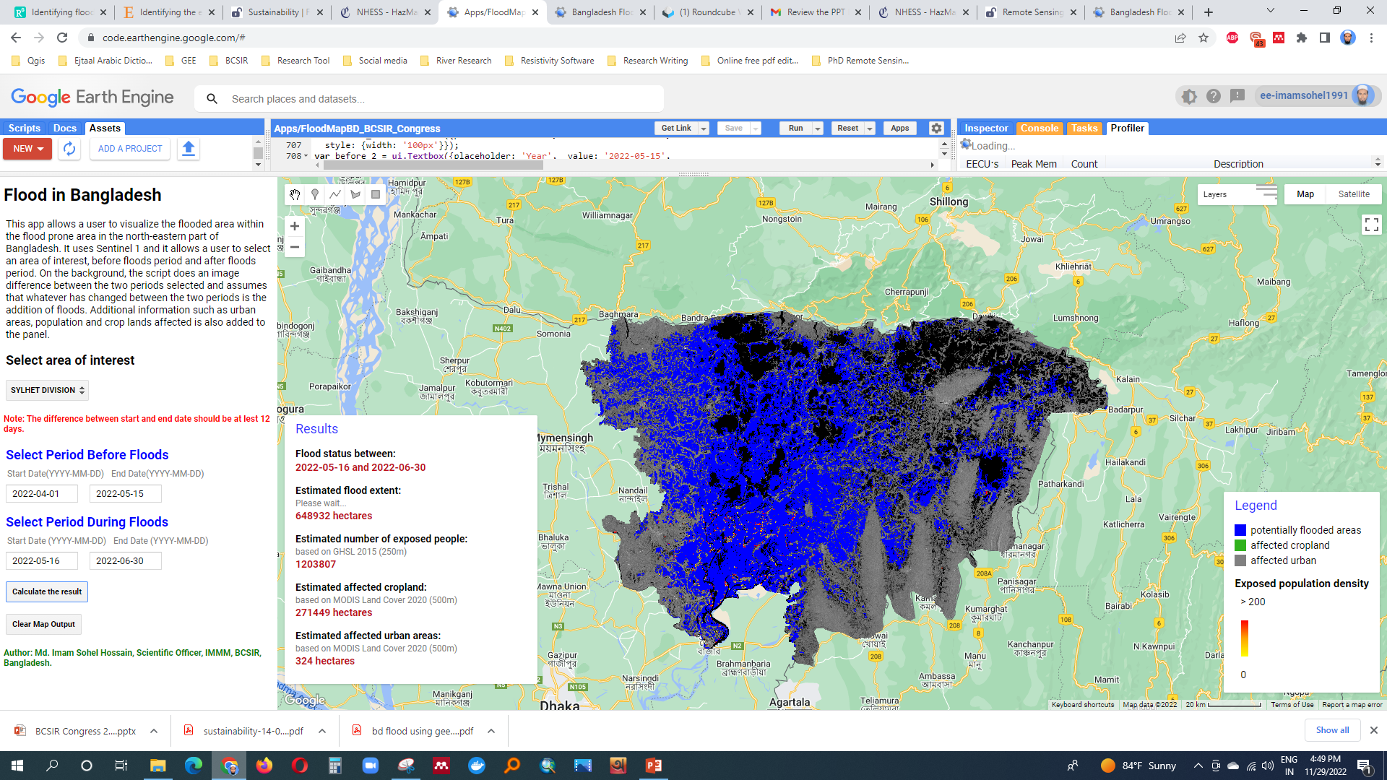
Findings-Divisional Scale

Slide 11
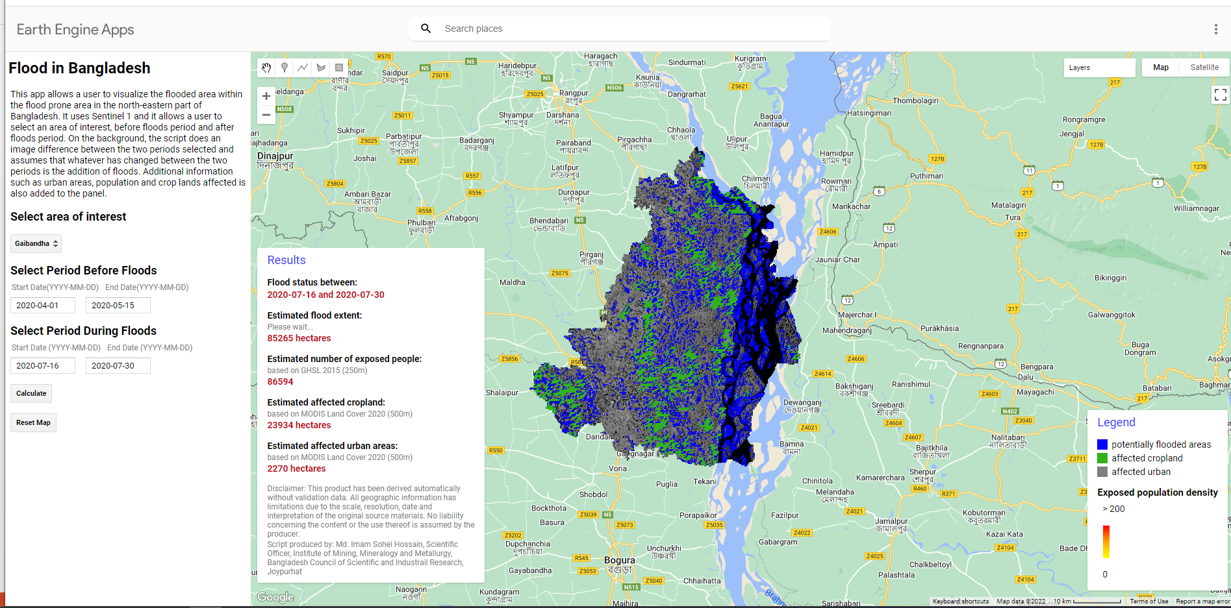
Findings-District Scale

Slide 12
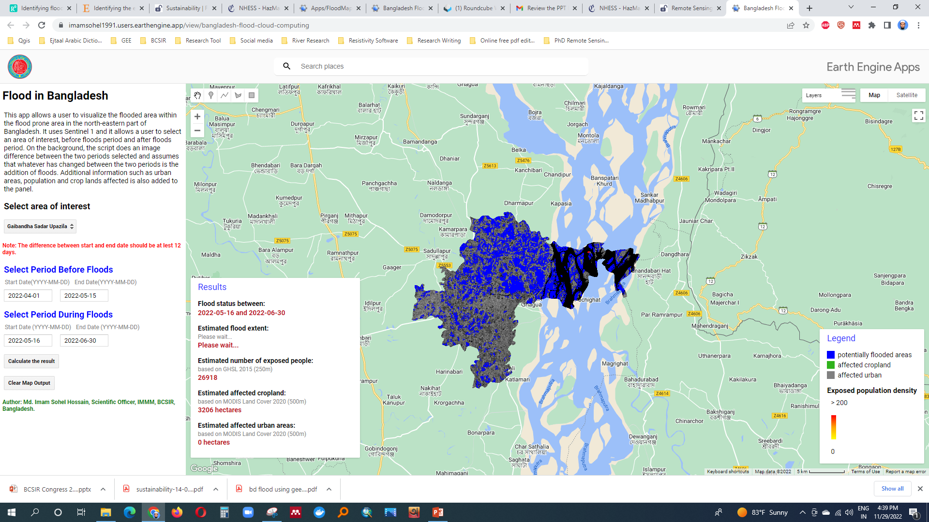
Findings-Subdistrict/Upazila Scale

Slide 13
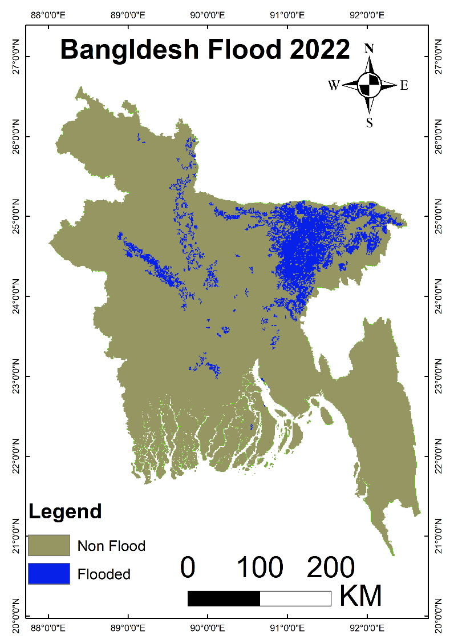
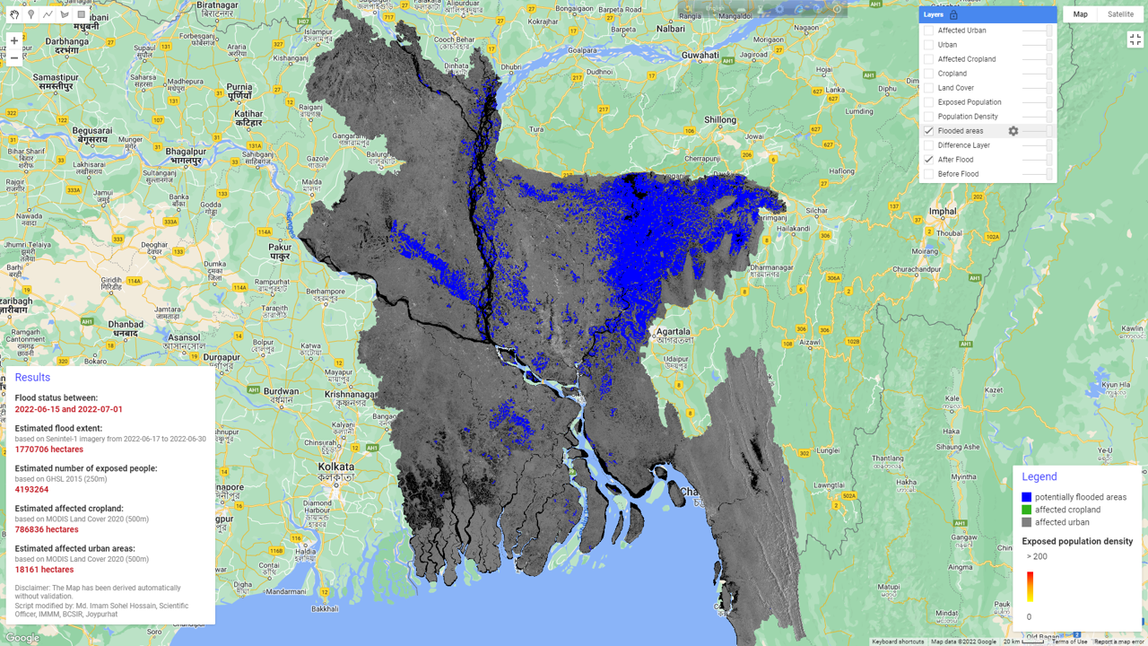
Findings-Future Flood Mapping and Modelling

Slide 14
Discussion
We developed the App and it is designed in an effective and efficient way to analyze big data
It is designed to map local to regional level flood which is aligned with the previous researches
However, our app is designed to estimate fast and reproducible flood areal extent, exposed population, cropland and urban area than other studies (Key Contribution)
Open a platform for future research -Technical and non technical
Specifically, aid to understand natural disaster occurrences and their spatial pattern
Thus, increase predictive capabilities for natural hazard events.
In the era of big data and cloud computing, our cloud based application will increase the pace at which researchers, policy makers can evaluate flood hazard in Bangladesh

Slide 15
Limitations and Future Recommendations
The tool only accesses datasets publicly hosted within the Google Earth Engine Data Catalog. While many researchers have the funding to pursue the use of datasets acquired on a near-daily basis (e.g., from Planet Labs, Inc.), it currently does not have a mechanism for ingesting these data
Validation of estimated data sets
With all of these limitations, it is important to recognize that Google is regularly making improvements and modifications to Earth Engine. We intend to monitor these activities and update the our application as needed to develop with future changes to Earth Engine

Slide 16
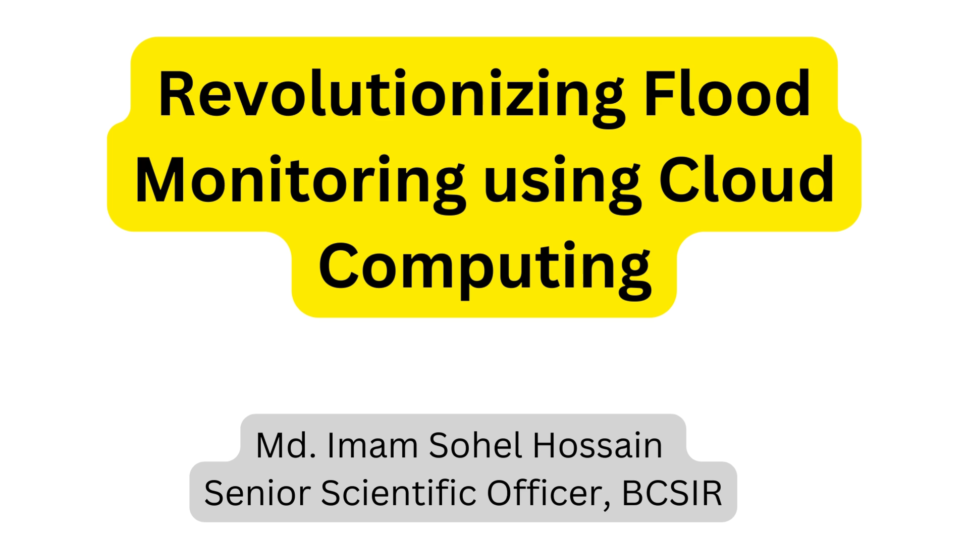
Conclusion

Slide 17
References
Notti, D.; Giordan, D.; Caló, F.; Pepe, A.; Zucca, F.; Galve, J.P. Potential and Limitations of Open Satellite Data for Flood Mapping. Remote Sens. 2018, 10, 1673. https://doi.org/10.3390/rs10111673
Ali, I.; Cao, C.; Naeimi, V.; Paulik, C.; Wagner, W. Methods to Remove the Border Noise From Sentinel-1 Synthetic Aperture Radar Data: Implications and Importance ForTime-Series Analysis. IEEE. 2018, 11, 3. https://doi.org/10.1109/JSTARS.2017.2787650
Canty, M. & Nielsen, A. Spatio-temporal analysis of change with Sentinel imagery on the Google Earth Engine. ESA Conference on Big Data from Space (BiDS), Toulouse, France. 28-30 Nov 2017. https://doi.org/10.2760/383579
Gorelick, N., Hancher, M., Dixon, M., Ilyushchenko, S., Thau, D., and Moore, R.: Google Earth Engine: Planetary-scale geospatial analysis for everyone, Remote Sens. Environ., 202, 18–27, https://doi.org/10.1016/j.rse.2017.06.031, 2017.

